Slide 1
Software Version Control
Aaron Hinton
Information Systems Programming Club
February 18th 2015

Slide 2
What We Will Cover
Software Version Control
Benefits
Distributed Systems
GIT
Centralized Systems
Team Foundation Version Control (TFVC)

Slide 3
What Is Version Control?
Version control is the systems and processes that track the changes in a file or files overtime. It also allows them to be reviewed or changed at a later date.
Can be hosted locally or a repository hosting
service/server
Repository – Collection of all project files and their associated changes

Slide 4
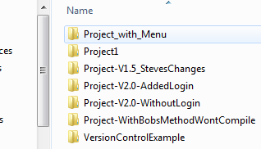
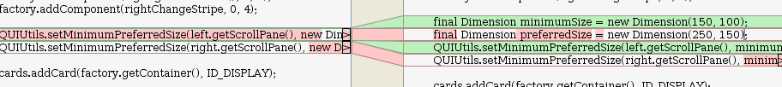
Why Version Control?
Simplifies file management
Allows changes to be tracked
Allows multiple people to work on the same files and keep track of each other’s work
Helps manage software development process

Slide 5
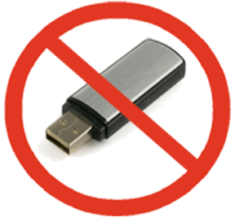


Practical Personal Applications
Manage a project across multiple computers and environments without having to constantly move and update files.
Easily record changes/modifications to files and allow for them to be reverted at a later time
Allow seamless collaboration on group projects

Slide 6
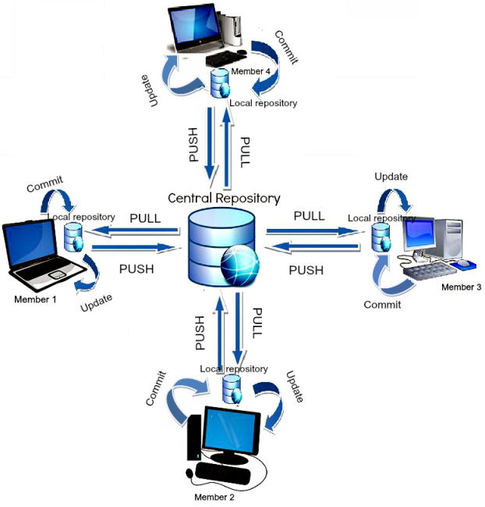
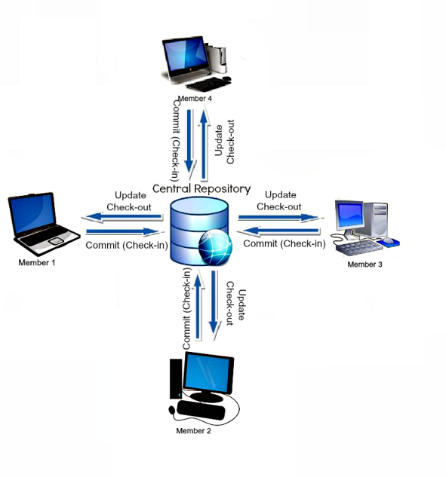
Distributed vs. Centralized
Distributed
Project repository distributed to local computers
Users work on their files locally and then record changes to central repository as necessary
Centralized
File history stored on central server
Users check-out files for editing and then check-in those files when finished

Slide 7
Distributed Version Control System DVCS
Benefits
Code is backed-up via multiple copies of the central repository
Numerous free hosting options
Popular for open-source development
Drawbacks
Takes sometime to become familiar with operations
Local repositories can get large since they encompass all changes

Slide 8


Current Popular Distributed Version Control Systems
Git
Created by the creator of Linux, Linus Torvalds in 2005
The most widely used version control system
Numerous hosting providers and resources
Open-Source (Free)
Mercurial
Created by Matt Mackall in 2005
Slightly easier to use
Open-Source (Free)

Slide 9
Git

Slide 10
Overview
Git is a distributed version control system
Typically a repository exists on a central server and is copied to each user’s computer
Allows user’s to work on a project locally and commit their changes at will.
Users have access to the entire history of changes locally.

Slide 11
Key Terms
Clone – to create a copy of a repository locally
Fork – cloning a repository owned by a 3rd party and then requesting for the changes to be accepted
Commit – saving a snapshot of the changes made to a local repository
Branch – Creating a separate record of revisions
Merge – merging two branches by combining the files
Revert – Undoing a commit or merge
Fetch – Retrieve changes to the remote repository
Pull – Fetch changes and merge them into the local repository
Push – Send changes on the local repository to the remote repository

Slide 12
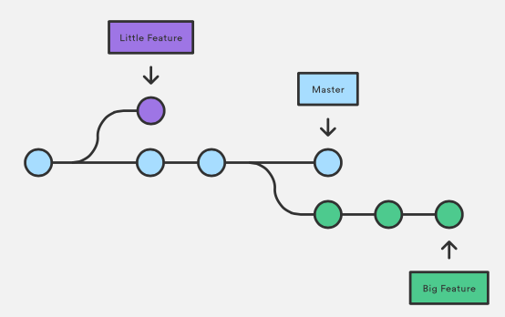
Git Structure Illustration

Slide 13
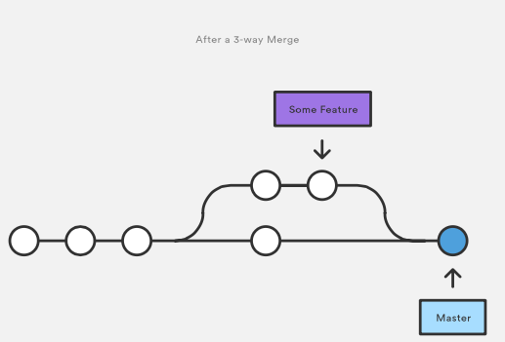
Illustration of a merge

Slide 14


Local & Hosted Repositories
A Git repository can be initialized and exist only as a local repository. However, this cancels out many benefits.
Repositories can be setup on servers or hosted through online providers like GitHub and Bitbucket

Slide 15
Git Program
PowerShell / Bash command line program
Available for free download @:
http://www.git-scm.com/downloads
Maybe included with some graphical Git applications

Slide 16
GUI Clients for Git
Several options for Git GUI Clients exist
GitHub Application
Great for learning Git
Basic Functionality
Lacks ability to do complicated operations
Git Extensions
Offers ability to manage multiple branches visually
Allows complex merges and operations
Has a higher learning curve
Further options listed at:
http://www.git-scm.com/downloads/guis

Slide 17
In-Class Demonstration
Creating a repository on GitHub
Cloning a repository locally
Making a change and committing it
Pushing those changes to the repository
Creating a branch
Merging branches

Slide 18
Additional Resources
Atlassian Git Tutorials
GitHub
Git : Homepage
Free Book: Pro Git (2014)

Slide 19
Centralized Version Control Systems

Slide 20
CVCS – Overview
Changes are recorded on a central repository
Users check-out files from the central repository and then check-in files when finished editing
Possible to create restrictions on checkouts, merges, and other individual controls
Size of project files on individual computers is smaller when the project is very large

Slide 21


Popular Centralized Version Control Systems
Microsoft Team Foundation Version Control
Proprietary
Free for up to 5 users
Used primarily by Microsoft “shops” ( C# , Visual Basic )
Subversion (SVN)
Open-Source
Unlimited Users
Free hosting providers for limited use

Slide 22
Hosting Options
Can be hosted on a local server with software purchase ($500)
Offsite repositories can be hosted on Visual Studio Online
First 5 Users are Free under basic plan
Basic plans are $20 a month per additional user and up
3rd Party hosting providers are also available
From $20 a month per user and up.

Slide 23
TFS – Key Terms
Check-Out – Download the latest file/files from the central repository
Check-In – Upload / Merge changed files to the central repository
Workspace – A container for projects
Branches and Merges – Same concept as with Git except changes occur and are managed via the central repository

Slide 24
TFVC Structure / Workflow
Once a TFS server has been established:
Files are downloaded from central repository
Files are then checked-out when editing
Files are checked-in when editing is complete
Checked-In files are managed and merge by the central repository / administrator

Slide 25
Team Foundation Server
In-Class Example
Login to Visual Studio Online account
Create TFS project/workspace
Download files locally
Check-In project files
Check-out files

Slide 26
Final Thoughts
Version Control Software Offers:
Efficient tracking of changes
Collaboration of multiple developers on a project
Code changes can be reviewed and accepted / declined
Hosting of Code in the “Cloud”
A useful tool to be knowledgeable on in modern software development

Slide 27
Questions & Answer

Slide 28
Works Cited
http://blogs.atlassian.com/2012/02/version-control-centralized-dvcs/
https://github.com
http://en.wikipedia.org/wiki/GitHub
https://subversion.apache.org
http://www.visualstudio.com/en-us/products/tfs-overview-vs.aspx
http://www.visualstudio.com/en-us/products/what-is-visual-studio-online-vs.aspx
https://www.atlassian.com

